Slide 1


Academic Performance & Attendance Analysis
Presented by:
Junaid Ashraf | Sushmeet Singh Bhatia | Anuj Patel | Sandeep Mandal | Ram Chandra Besra | Vansh Das |
Rungta College of Engineering
Date: 24/12/25

Slide 2

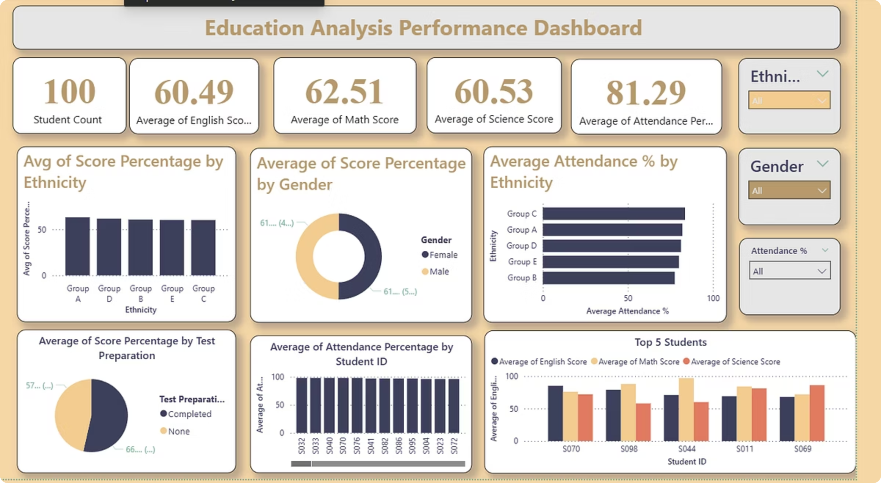
Education Performance Dashboard
Academic Performance & Attendance AnalysisTransforming raw student data into actionable institutional insights using Power BI.

Slide 3


The Challenge: From Data to Insight
“Institutions have a lot of student data, but manual analysis is slow and unclear. It is difficult to track subject performance, understand the impact of attendance, and identify performance gaps across gender and ethnicity.”
Our Objective: Build an interactive Power BI dashboard that centralizes metrics for data-driven decision making.

Slide 4



Project Strategic Objectives
Performance Tracking
Demographic Trends
Correlation Study
Real-time analysis of academic scores across core subjects like Math, English, and Science.
Identify and address performance variations based on gender, ethnicity, and parental education.
Scientifically analyze the impact of attendance and test preparation on student success.

Slide 5

Dataset Architecture & Preparation
We utilized a comprehensive student performance dataset to build the foundation of our analysis.
Data Sourcing
1
Imported raw Excel data containing 100 unique student profiles and standardized all ID fields.
Cleaning & ETL
2
Structured the dataset in Power Query, handling missing values and ensuring data type consistency.
Calculated Measures
3
Developed DAX formulas for Score Percentage and Average Attendance to enable deeper filtering.

Slide 6
Key Performance Indicators (KPIs)
The high-level summary provides administrators with an immediate pulse-check on institutional health.
100
72%
85%
68
Total Students
Avg. Score
Avg. Attendance
Math Average
Active enrollment analyzed
Aggregate across all subjects
Daily presence rate
Primary focus area for growth

Slide 7
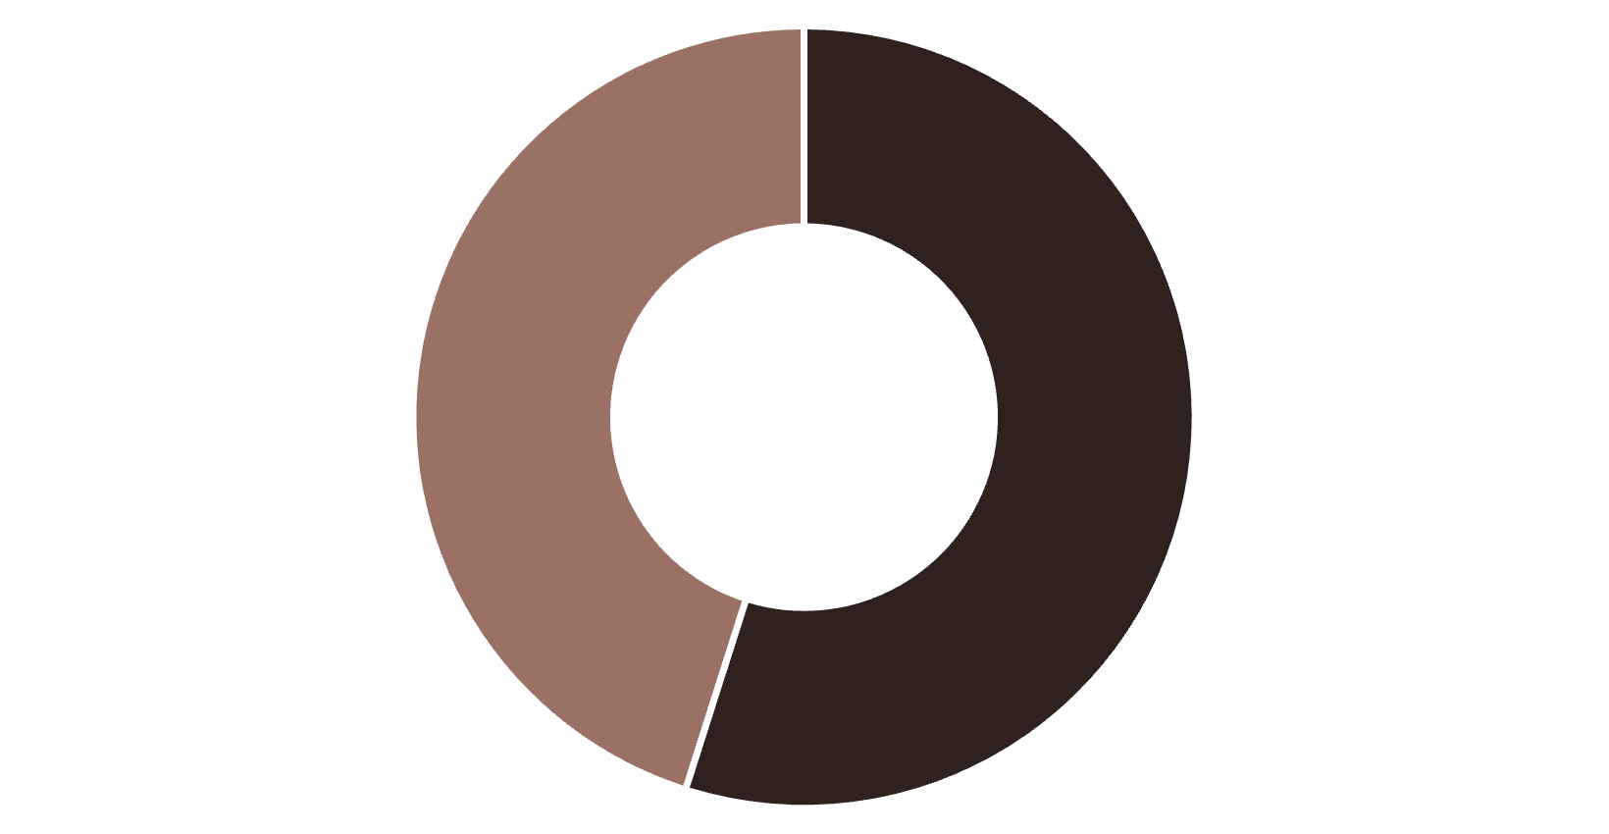
Academic Performance Analysis
Core Insights
Preparation Matters: Students who completed test prep scored 14% higher on average.
Equity Gaps: Ethnicity-wise comparison reveals specific groups requiring targeted support.
Gender Balance: Performance levels remain largely consistent across genders with slight variations in Science.
Completed Prep
No Prep
Impact of Test Preparation on Scores

Slide 8



The Attendance-Performance Link
A critical finding of our study is the direct correlation between classroom presence and academic outcomes.
High Attendance
Better Engagement
Prep Completion
Higher Scores
High Presence
At-Risk Students
Groups with >90% attendance consistently rank in the top performance tier.
Identifying students falling below 70% attendance for early intervention.

Slide 9
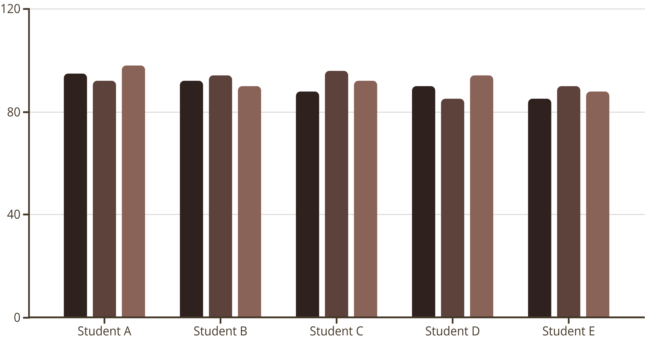
Student-wise Deep Dive
Top 5 Performers Comparison
Math
English
Science
Individual analysis allows educators to understand subject-specific strengths and weaknesses for the highest-achieving cohort.

Slide 10


Advanced Tooling & Interactivity
Dynamic Slicers
Drill-Down Capabilities
Filter the entire dashboard by Gender, Ethnicity, or Parental Education with a single click.
Move from institutional overviews to individual student records to find the root cause of trends.
By leveraging Power BI Desktop and Excel, we've turned static numbers into a living conversation.

Slide 11

Conclusion & Strategic Insights
Prep is Key
Attendance Focus
Incentivizing test preparation courses will yield the highest ROI on student scores.
Administrators should monitor the 70-80% attendance bracket to prevent academic decline.
Data Maturity
Visual dashboards reduce reporting time by 60% compared to traditional spreadsheet methods.
Ready for Data-Driven Education

